Slide 1
AREA III:
AB Structures and Environment Engineering and Bioprocess Engineering and Allied Subjects

Slide 2
TOPIC 1:
Agricultural Buildings and Structures
1.4 Supervise and manage the construction, operation and maintenance of agricultural buildings and structures with the application of PERT CPM, CPES etc.
Number of items: 2-3 questions
Coverage: PERT-CPM, CPES

Slide 3
Project Planning
The construction, operation, and maintenance of agricultural buildings and structures are parts of project planning.
Gantt Charts
Network Analysis: Deterministic Networks
Log frame Analysis

Slide 4
Deterministic Networks
Networks are graphic representations of the major activities or work elements of a project.
The use of deterministic networks requires a project which consists of well-defined jobs, jobs which may be stopped or started independently, and jobs which must be ordered in a given sequence.
Network-based management systems of PERT and CPM were developed originally in industry and the military as an aid to managing large complex projects.

Slide 5
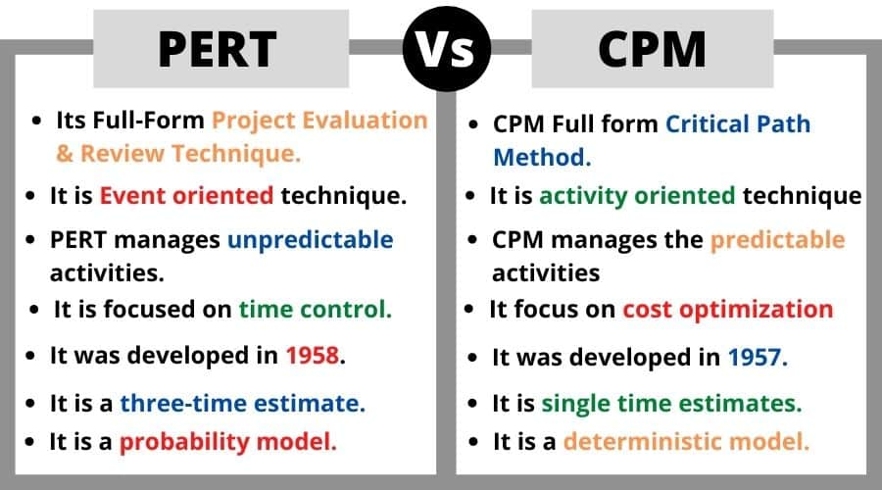
PERT and CPM
PERT = Project/Program Evaluation and Review Technique
CPM = Critical Path Method
https://images.app.goo.gl/awEGYMKt9xdebQFz7

Slide 6
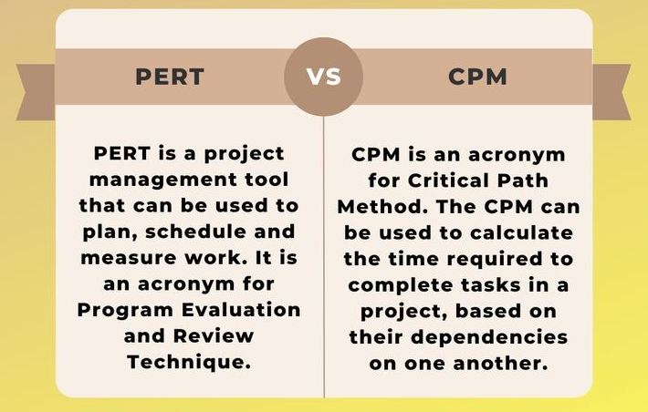
PERT and CPM
PERT = Project Evaluation and Review Technique
CPM = Critical Path Method
https://images.app.goo.gl/5ZzWHxcfEaQ2Zg4R9

Slide 7
PERT and CPM
PERT focuses on events and milestones, reporting data based on completed objectives, making it most useful for planners and policy-makers involved in the project.
CPM is activity-oriented and provides data that helps evaluate work as it progresses, making it more beneficial for the operational team members. The preparation of an accurate network using CPM requires time, skills, familiarity with various aspects of the project, and a high degree of interaction among all participants.

Slide 8
PERT and CPM
PERT and CPM has two major components:
Activity
Event
“A” is the activity: an action and consumption of resources (time, money) required to complete a portion of project, represented by an arrow.
“i” and “j” are the events or nodes: they will always occur at the beginning and end of an activity.
A
i
j

Slide 9
PERT and CPM
Note that one or more activities can start and end simultaneously at an event.
Merge event Burst event
i
j

Slide 10
PERT and CPM
PRECEEDING and SUCEEDING ACTIVITIES
A
C
i
j
l
B
D
k

Slide 11
PERT and CPM
DUMMY ACTIVITY – activity that does not consume resources. Only used to represent a connection between events to maintain a logic in the network.
l
B
A
i
j
Dummy
C
k

Slide 12
Sample questions
Given the sequence of activities for the construction of poultry house, create a network diagram representing the construction project.
Name of activity | Starting and finishing event | Description of activity | Predecessor | Duration (days)
A | (1,2) | Prepare the plan | -- | 4
B | (2,3) | Procure a supplier and labor | A | 7
C | (3,4) | Collect the materials for construction | B | 14
D | (3,5) | Construct the poultry house | B | 58
E | (4,6) | Install wiring | C | 5
F | (5,6) | Finish and polish the poultry house | D | 6

Slide 13
PERT and CPM
4
E
C
6
1
2
3
A
B
D
F
5

Slide 14
Sample questions
Consider the project given on the table. Construct a network diagram using the sequence of activities for agricultural building construction project.
Name of activity | Description of activity | Predecessor
A | Purchase of land | --
B | Preparation of building plan | --
C | Level or clean the land | A
D | Register and get approval | A,B
E | Construct the building | C
F | Finish and polish the building | D

Slide 15
PERT and CPM
C
E
A
F
B
D

Slide 16
Critical Path Analysis
Terminologies
Critical path – longest path through the entire network. This is the path on which any delay in the project will affect the project schedule. This is the shortest time allowable for the project completion.
Total Float – difference between the latest start time and the earliest start time of that activity. Also called slack, float, or path float)
Free float – time by which the completion of an activity can be delayed from its earliest finish time without affecting the earliest start of time of the succeeding activity.

Slide 17
Critical Path Analysis
Formula
Total Float
Late Finish (LF) – Early Finish (EF) = Total Float
Late Start (LS) – Early Start (ES) = Total Float
Free float
(Early Finish (j) – Early Finish (i)) – duration of activity (ij)
Critical path must satisfy the following:
1. LF – ES = 0
2. LF (j) – duration of (ij) – ES (j) = 0

Slide 18
Sample questions
Activity | Predecessor | Duration (days)
A | - | 3
B | A | 5
C | A | 7
D | B | 10
E | C | 5
F | D,E | 4
Determine the least duration of the project.
Determine the critical path.
Determine the slack time.

Slide 19
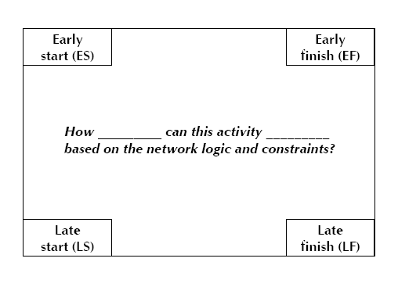
Sample questions

Slide 20
Sample questions
Forward Pass (to calculate Early Start)
Step 1: Begin from the start event and move towards the end event.
Step 2: Put ES = 0 for the start event.
Step 3: Go to the next event (i.e., node 2) if there is an incoming activity for event 2, add calculate ES of previous event (i.e., event 1) and activity time.
Note: If there are more than one incoming activities, calculate ES for all incoming activities and take the maximum value. This value is the ES for event 2.
Step 4: Repeat the same procedure from step 3 till the end event.

Slide 21
Sample questions
Backward Pass (to calculate Late Finish)
Step 1: Begin from end event and move towards the start event. Assume that the direction of arrows is reversed.
Step 2: Latest Time LF for the last event is the earliest time. ES of the last event.
Step 3: Go to the next event, if there is an incoming activity, subtract the value of LF of previous event from the activity duration time. The arrived value is LF for that event. If there are more than one incoming activities, take the minimum ES value.
Step 4: Repeat the same procedure from step 2 till the start event.

Slide 22
Sample questions
Activity | Predecessor | Duration (days)
A | - | 6
B | A | 8
C | A | 10
D | B | 13
E | C | 8
F | D | 9
G | E,F | 14
Determine the least duration of the project.
Determine the critical path.
Determine the slack time.

Slide 23
THANK YOU!!!
Proverbs 3:5-6
“Trust in the Lord with all your heart and lean not on your own understanding; in all your ways submit to Him, and He will make your paths straight”

